Slide 1

Android Studio 4.0 Installation Procedure

Slide 2
Software Requirements
Java Development Kit 14
https://www.oracle.com/in/java/technologies/javase-downloads.html
Android Studio 4.0
https://developer.android.com/studio/#downloads

Slide 3
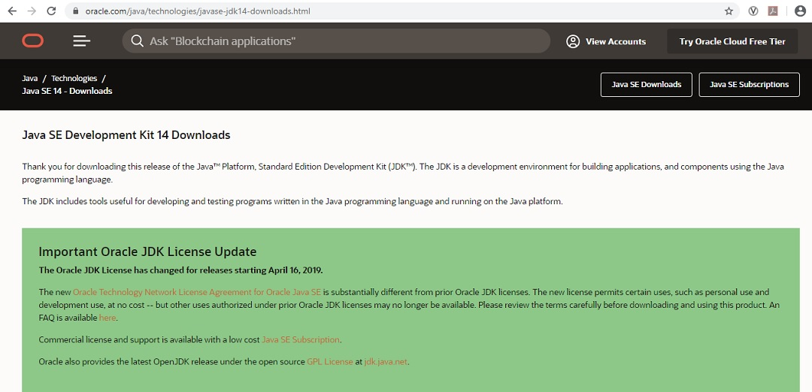
Download JDK 14

Slide 4
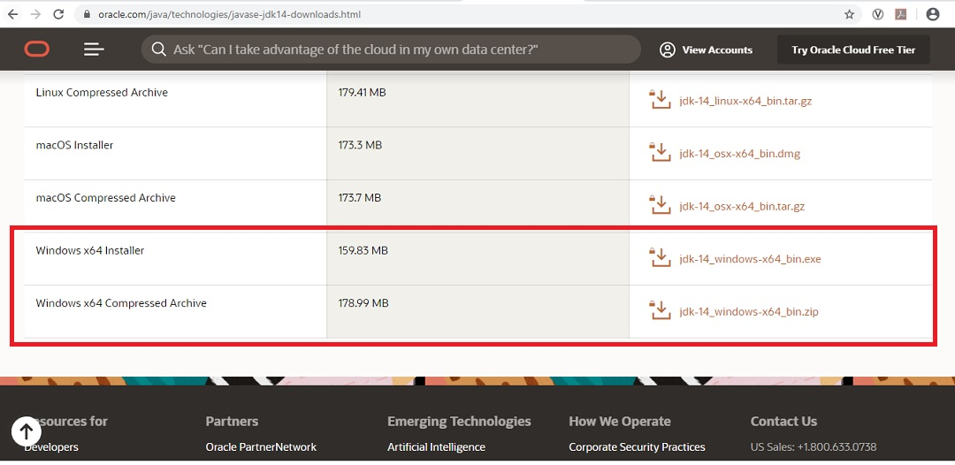
Select the Operating System

Slide 5
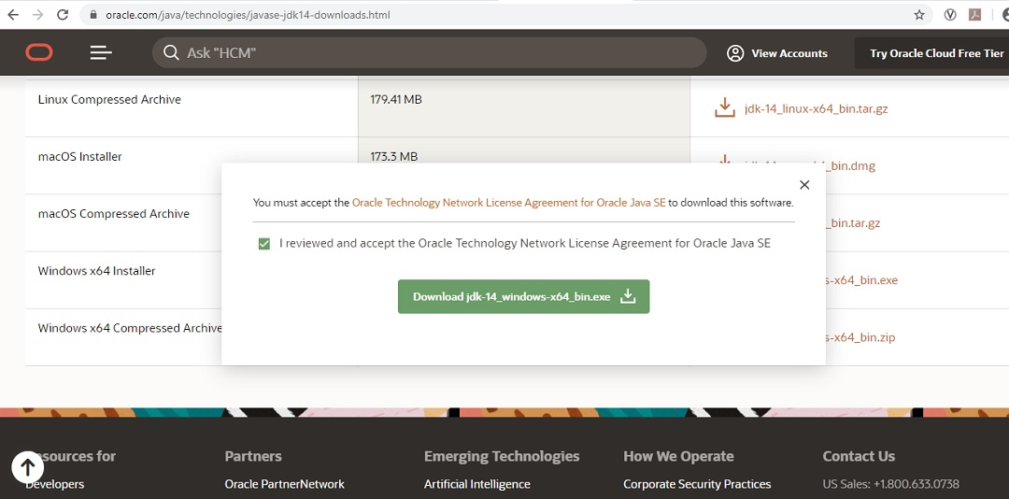
Click on Download

Slide 6
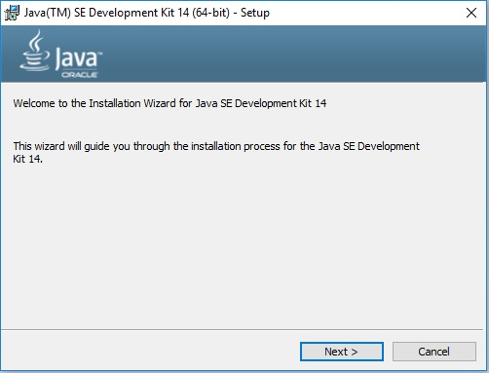
The Java SE Development has been successfully

Slide 7
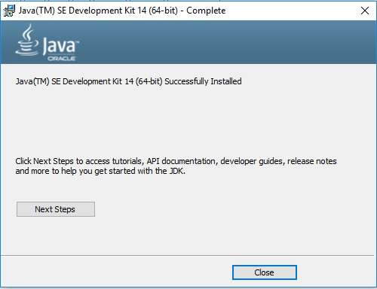
After download, open the file. Click next.

Slide 8
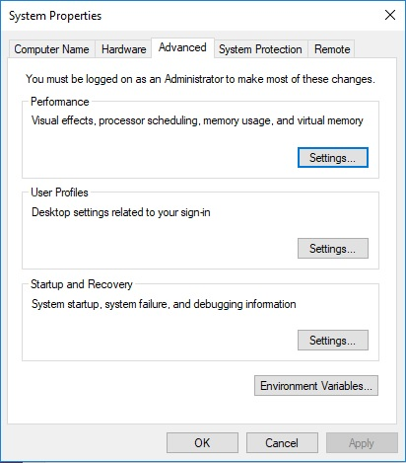
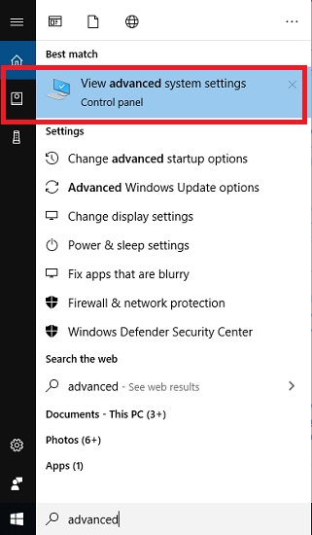
Add Java Path to the environment variable

Slide 9
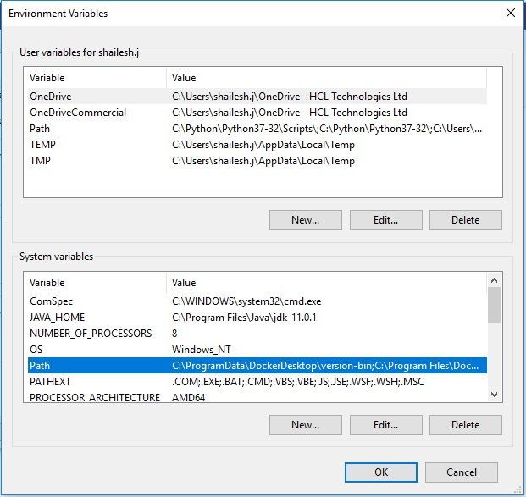
Under System variable – click on path and click edit

Slide 10
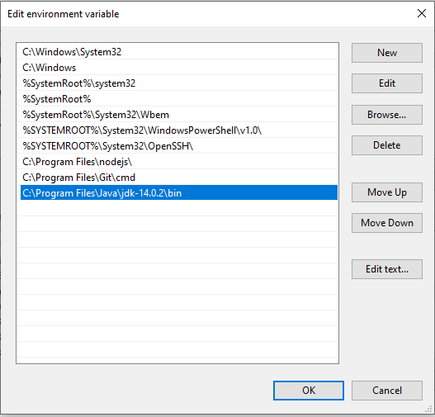
Add the JDK bin directory

Slide 11
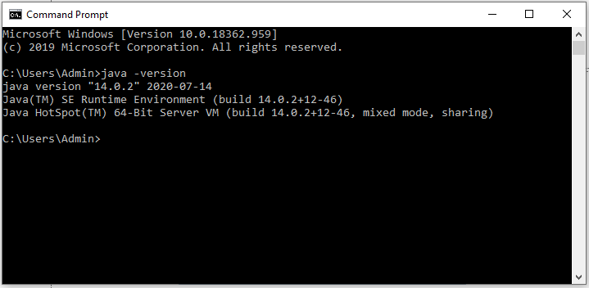
Check the java version

Slide 12
PROCEDURE TO INSTALL ANDROID STUDIO

Slide 13
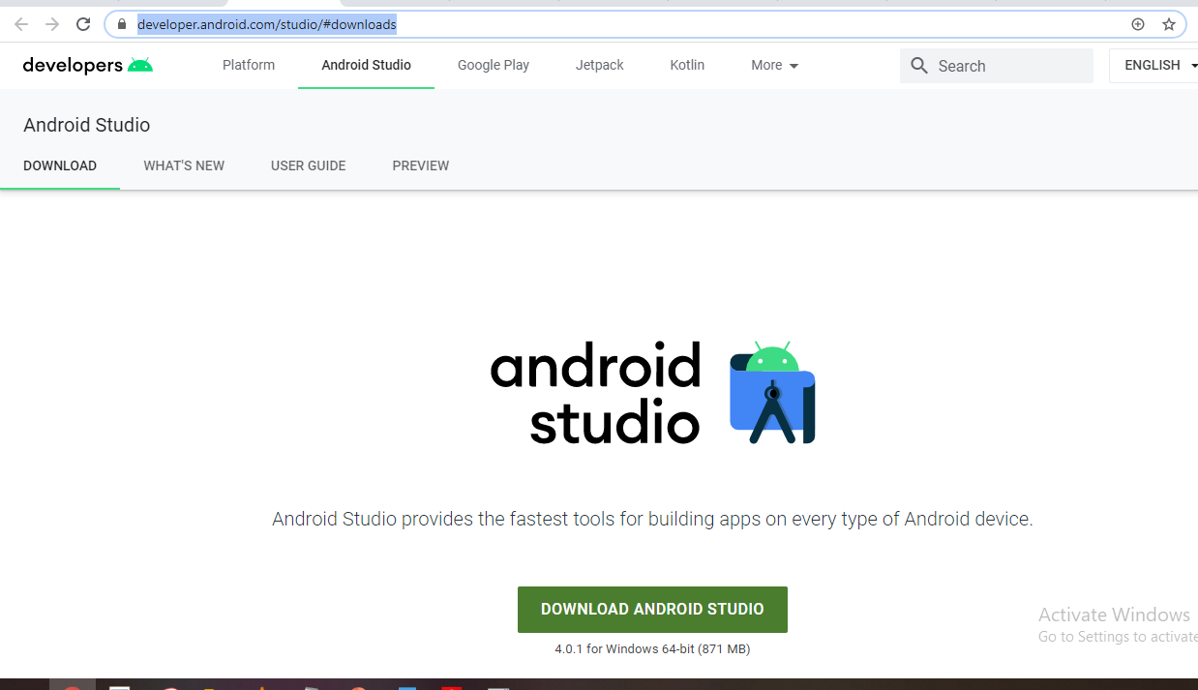
Go to
https://developer.android.com/studio/#downloads

Slide 14
Click on the download android studio button .

Slide 15
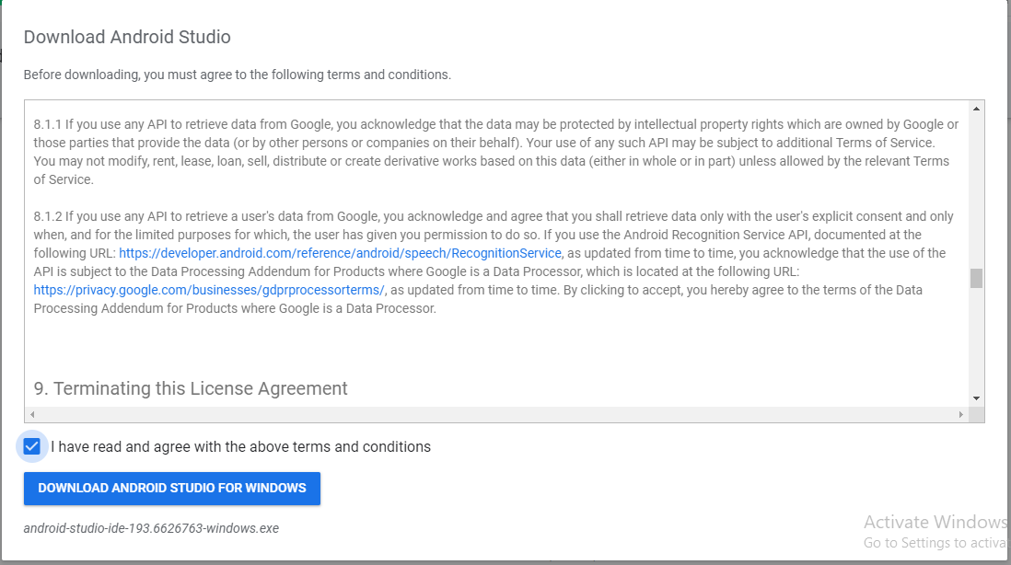
Click on the “I have read and agree with the above terms and conditions” checkbox followed by the download button.

Slide 16
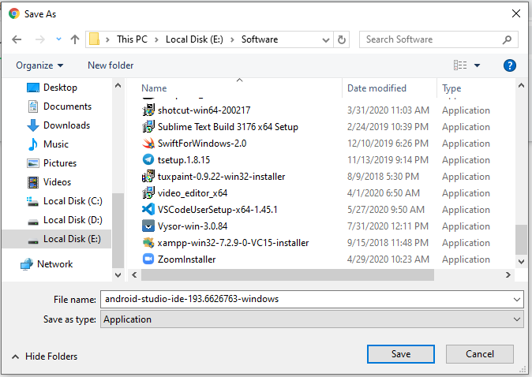

Slide 17
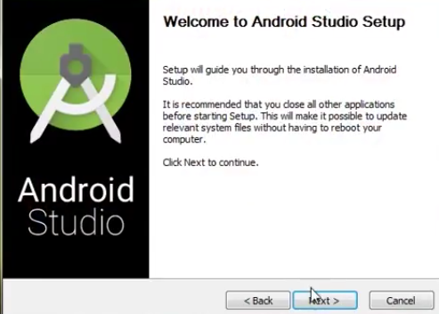
After the downloading has finished, open the file from downloads and run it . It will prompt the following dialogue box .

Slide 18
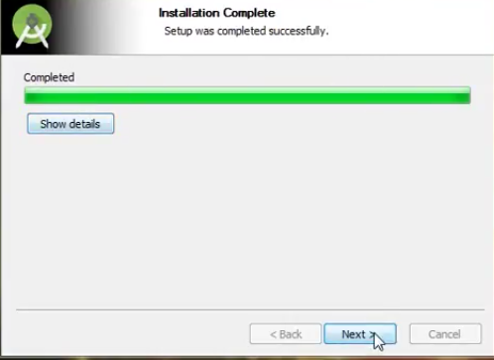
It will start the installation, and once it is completed, it will be like the image shown below.

Slide 19
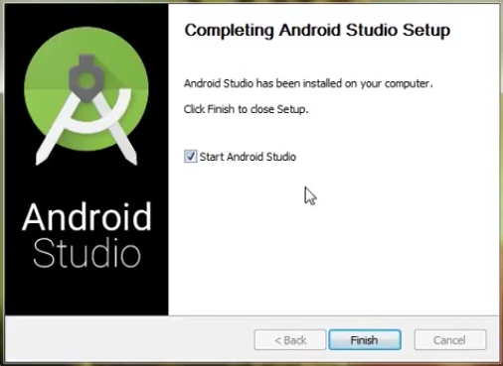
Click on next .

Slide 20
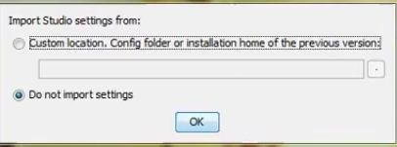
Once “Finish” is clicked, it will ask whether the previous settings needs to be impoerted [if android studio had been installed earlier], or not. It is better to choose the ‘Don’t import Settings option’ .
Click the OK button.

Slide 21


This will start the Android Studio. Meanwhile it will be finding the available SDK components .

Slide 22
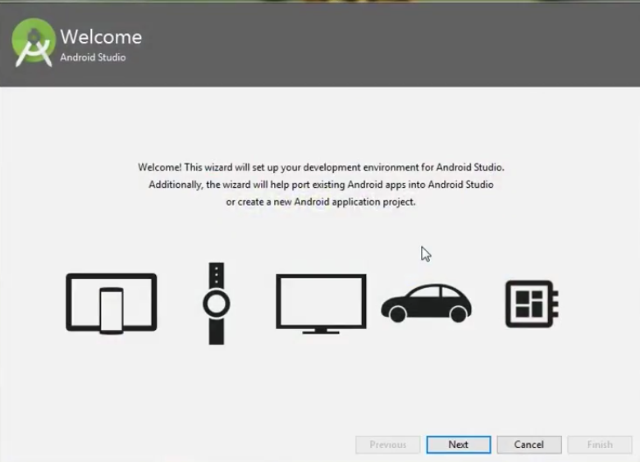
After it has found the SDK components, it will redirect to the Welcome dialog box .

Slide 23
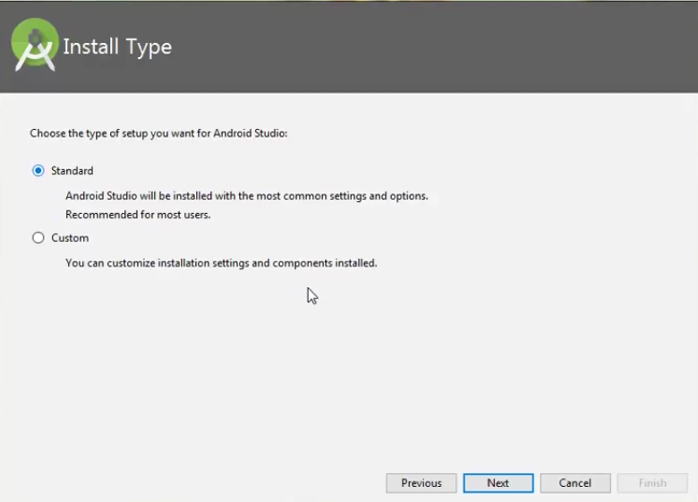
Click on next .

Slide 24
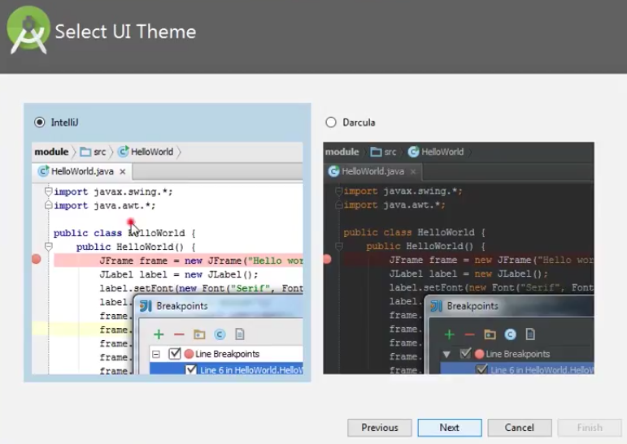
Choose Standard and click on Next. Now choose the theme, whether Light theme or the Dark one . The light one is called the IntelliJ theme whereas the dark theme is called Darcula . Choose as required.
Click on the Next button

Slide 25
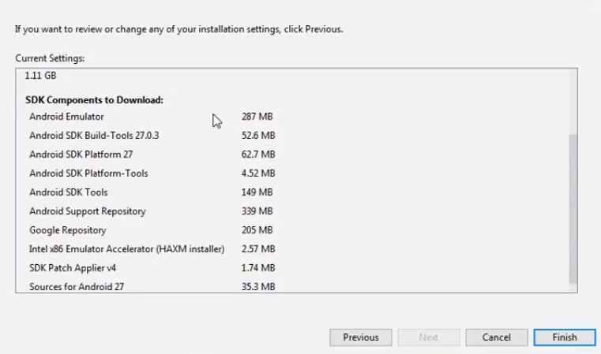
Now it is time to download the SDK components .
Click on Finish .

Slide 26
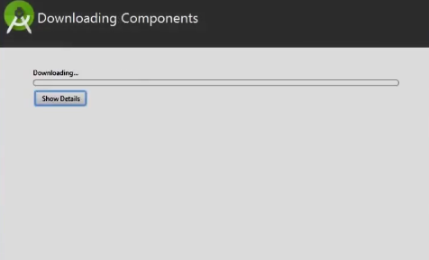
It has started downloading the components

Slide 27
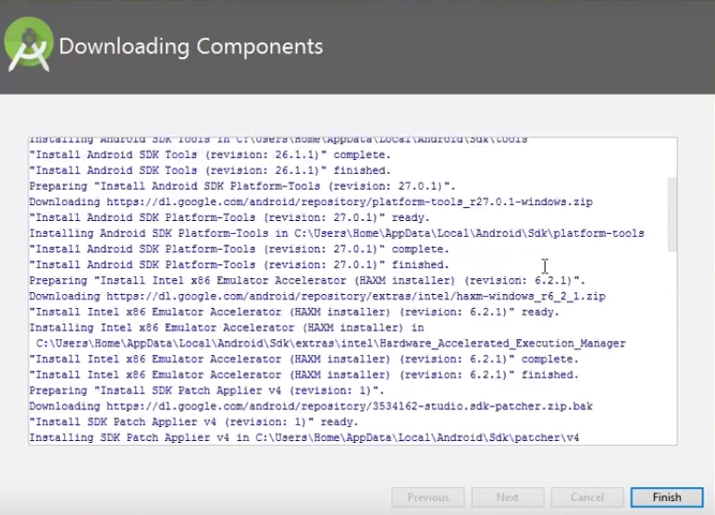
The Android Studio has been successfully configured. Now it’s time to launch and build apps.
Click on the Finish button to launch it.

Slide 28
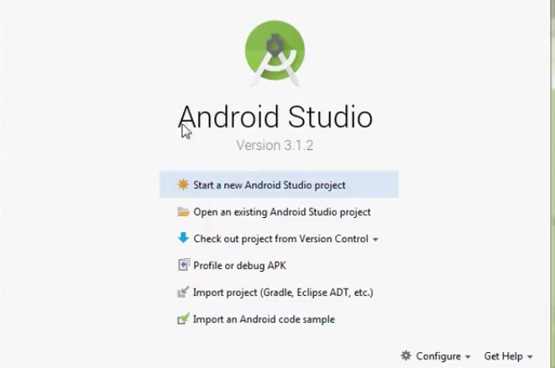
Click on ‘Start new android project’ to build a new app.

